Slide 1
Chemistry
Precision and Accuracy
LabRat Scientific
© 2018

Slide 2
PRECISION:
How repeatable the measurement is. For example, if you measure the temperature with 10 different thermometers and they all read the same value, then the thermometers are very precise.
ACCURACY:
How close the measurement is to the actual value. For example, if your thermometer is not calibrated very well, it might read 95 F when it is actually 100 F (as measured by a well calibrated thermometer). In this case, your data is not going to be accurate.

Slide 3
Precision & Accuracy
Let’s look at the bulls eye example. The RED spot represents the “true” value… The “clustering” of the data points represents the “precision”. The distance from the red spot represents “accuracy”
Neither Precise nor Accurate
Precise and Accurate
The data has a tight clustering (repeatable) and it is very close to the bull’s eye
Precise, but not Accurate
Is it possible to have a data set that is not precise, but is accurate?
No, if the data is not “precise”, then that means the data points are spread out. One point could be “accurate”, but since the data is spread out, the other points will not be accurate.

Slide 4
Precision & Accuracy
Thought Experiment – You are taking measurements of the Air Density and its dependence on Air Temperature. You are using a thermometer and a pressure gauge to make your measurements. The BLUE dots are your first data set. The GREEN dots are a second data set after repeating the experiment. The RED line is the linear curve-fit mathematically determined using the data you collected.
High Density
Remember - “Precision” is how repeatable the measurement is.
Notice that the data seemed a bit random, and data from Trial 1 (BLUE) did not line up real well with Trial 2 (GREEN)… This data is not very Precise…
Air Density
Low Density
Low Temp
Air Temperature
Hi Temp

Slide 5
Precision & Accuracy
Thought Experiment – You do the experiment again, but are much more careful.
High Density
Remember - “Precision” is how repeatable the measurement is.
Notice that the data is a little more “behaved” and the data from Trial 1 (BLUE) lines up quite well with Trial 2 (GREEN). This data is fairly Precise…
Air Density
Low Density
Low Temp
Air Temperature
Hi Temp

Slide 6
Precision & Accuracy
But is the data “accurate”? Accuracy is a comparison to the “true” values… What if your thermometer was not calibrated (i.e. was reading wrong)? In this case the temperatures were not “accurate”.
High Density
Here the BLUE and GREEN data are repeatable so the data is still “precise”, but the temperatures are not correct due to the mis-calibrated thermometer. Hence the data is NOT “Accurate”
Air Density
The “true” temperature
Low Density
Low Temp
Air Temperature
Hi Temp

Slide 7
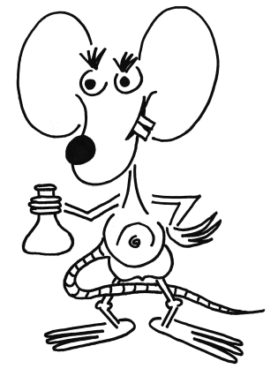
Questions?

